Slide 1



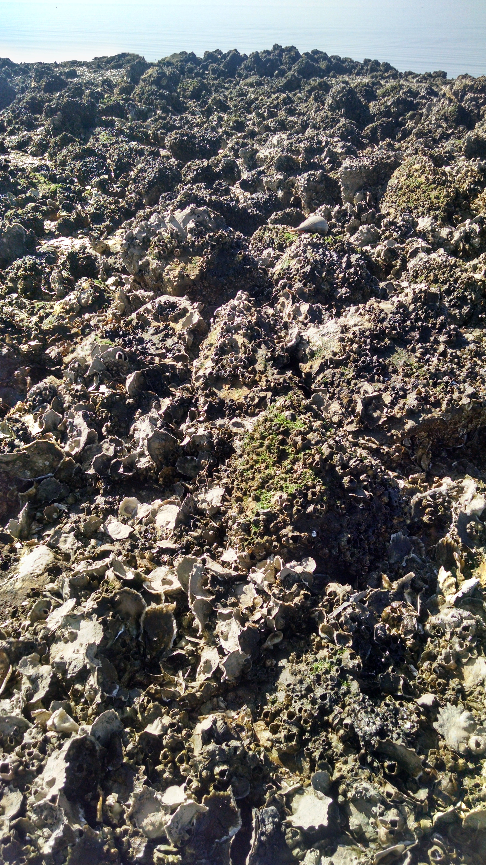
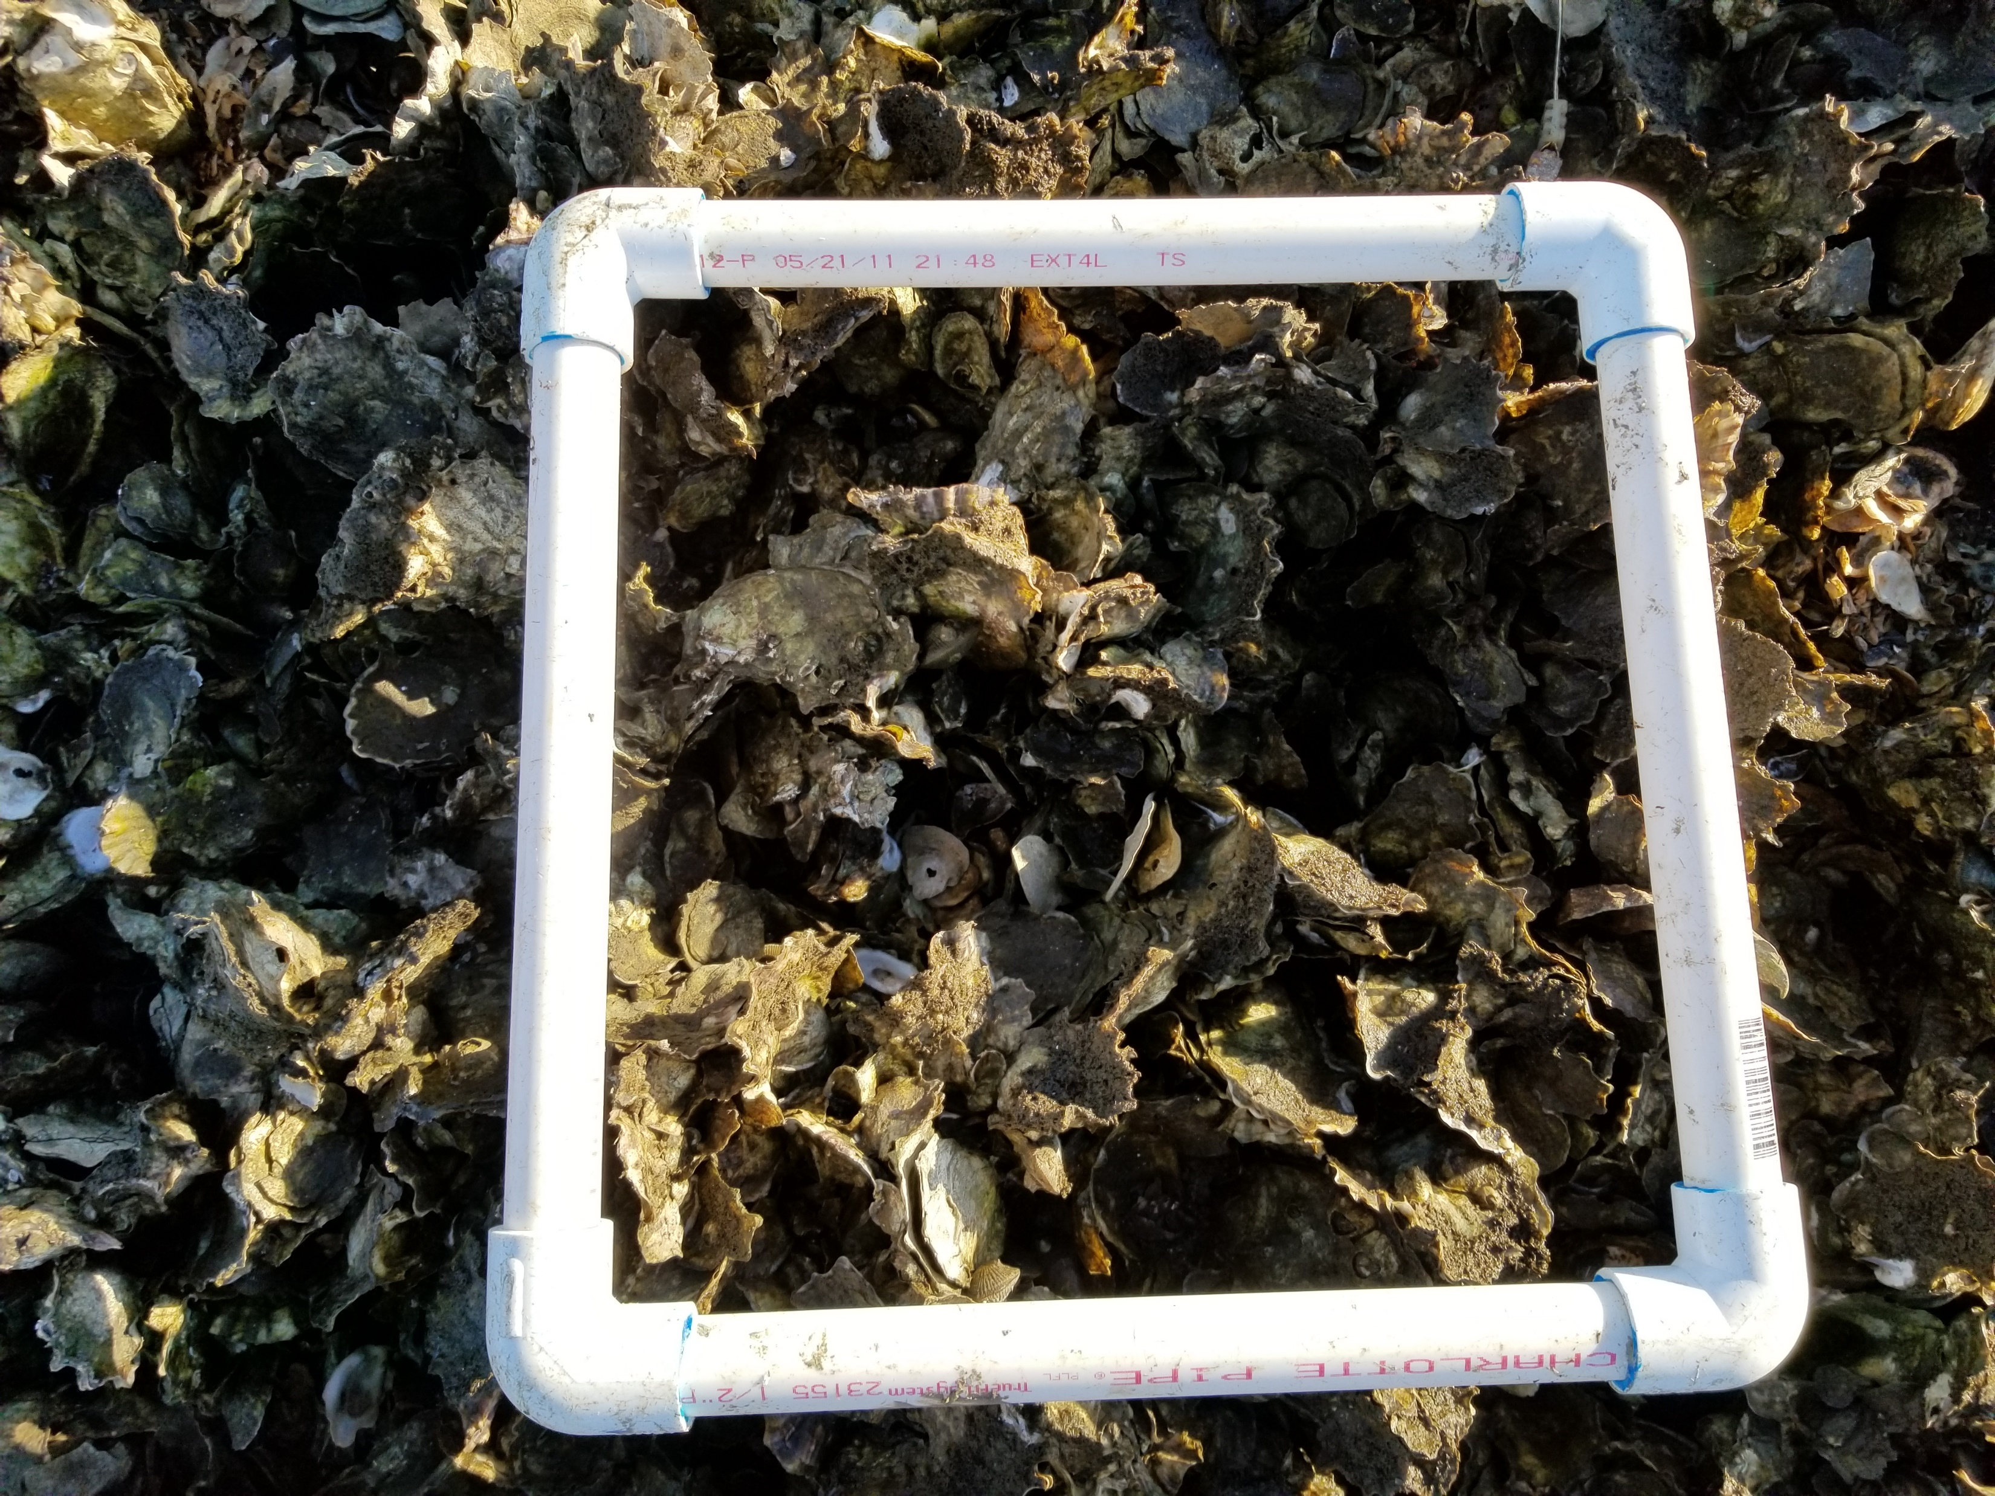
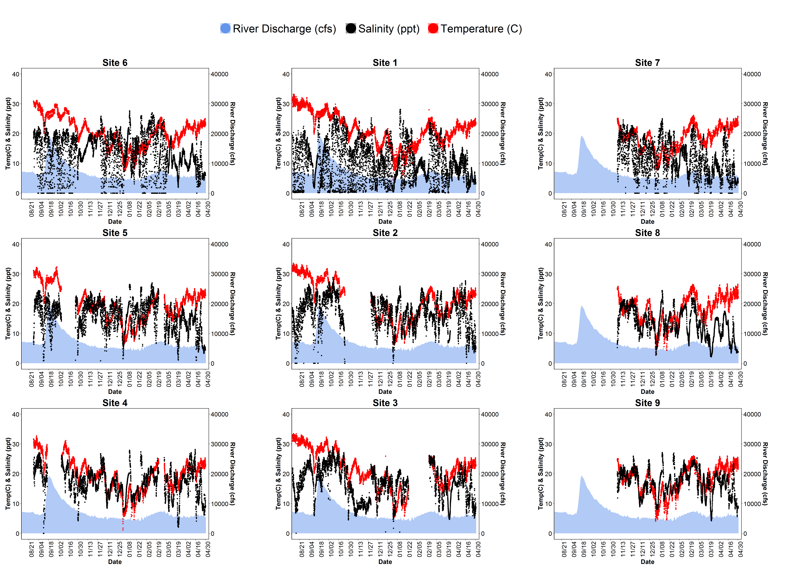

Big Changes in the Big Bend:
A Data Management Story
Data Collection
Discussion
Decision Making
Synthesis
QA/QC
Analysis
Version Control
References

